Slide 1
Fundamentals of Machine Learning Week 2: exploratory data analysis
Jonas Moons
All images are either own work, public domain, CC-licensed or fair use
Credits on last slide

Slide 2
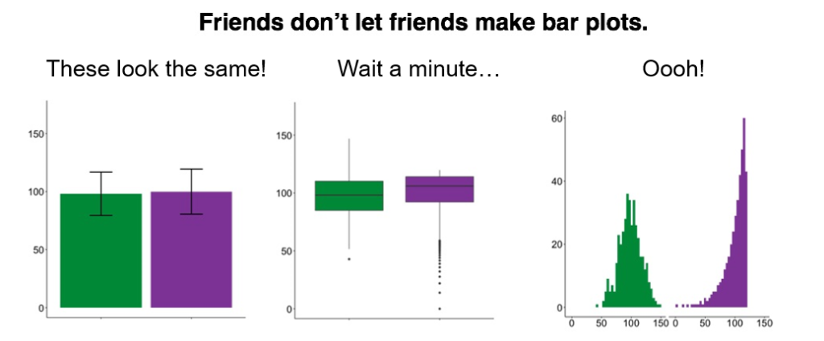
Time for some nerdy humor…
Blog

Slide 3
Bar graphs
Blog

Slide 4
Notes on assignments
There are exercises during class
Post to GitHub & Slack
Please do delete the Fitbit data set
In addition to that, there are weekly assignments as homework
Post to Github & Canvas (except Fitbit data)
A prerequisite for the final assignment

Slide 5
Topics
Terminology
Exploring 1 or 2 categorical variables
Exploring 1 categorical & 1 numerical variable
Exploring 2 numerical variables

Slide 6
Population and sample
Population is the group of individuals (people, companies) that are the topic of the research
Not always clearly defined
Sample: part of population included in research
Random sampling often preferable (often not possible)
Sample bias: bias due to non-random sampling

Slide 7
Notation
Measure | Sample statistic | Population parameter
Mean |  | μ
Standard deviation | s | σ
Variance | s² | σ²
Size | n | N

Slide 8
Level of measurement
 |  |  | Ratio
 |  | Interval | true zero point
 | Ordinal | equal difference | equal difference
Nominal | ranking | ranking | ranking
distinction | distinction | distinction | distinction
gender | opinion | temperature | age
categorical numerical
qualitative quantitative

Slide 9
Quiz
Heart rate
School grade (1-10)
Hair color

Slide 10
Quiz
Heart rate = ratio
School grade (1-10) = ordinal
Hair color = nominal

Slide 11
Independent and dependent variables
A dependent (Y) variable is studied for changes when the independent (X) variable(s) changes
Example:
independent variables: boredom, age
dependent: social media use
Correlation is not causation! Ice cream sales and drownings are correlated, but ice cream sales don’t cause drownings
Target (Y) and predictor (X) are used more in the machine learning world

Slide 12
Topics
Terminology
Exploring 1 or 2 categorical variables
Exploring 1 categorical & 1 numerical variable
Exploring 2 numerical variables

Slide 13
Bar charts

Slide 14
Crosstables
 | Gender
Region | Male | Female | Total
Central | 48% | 11% | 37%
North | 33% | 56% | 40%
South | 19% | 33% | 23%
Total | 100% | 100% | 100%
 | Gender
Region | Male | Female | Total
Central | 10 | 1 | 11
North | 7 | 5 | 12
South | 4 | 3 | 7
Total | 21 | 9 | 30
Column percentages: distribution of men/women over regions
 | Gender
Region | Male | Female | Total
Central | 91% | 9% | 100%
North | 58% | 42% | 100%
South | 57% | 43% | 100%
Total | 70% | 30% | 100%
Row percentages: ratio of men/women per region

Slide 15
Exercise 1: exploring categorical variables
See the example Notebook exploring_categorical_variables
Choose one of the categorical variables in the class data set (seee exercise folder) as your independent variable, and a dependent categorical variable.
Using Seaborn and Pandas, make:
A table with frequencies of your independent variable
A suitable graph of your independent variable
A crosstable with column proportions or percentages
A simple bar graph (not stacked) of the relation between the variables
What is your conclusion about the relation between the variables?
Try and find the relation between a categorical and a numerical variable. Plot this relation. What conclusion can you reach?

Slide 16
Topics
Terminology
Exploring 1 or 2 categorical variables
Exploring 1 categorical & 1 numerical variable
Exploring 2 numerical variables

Slide 17
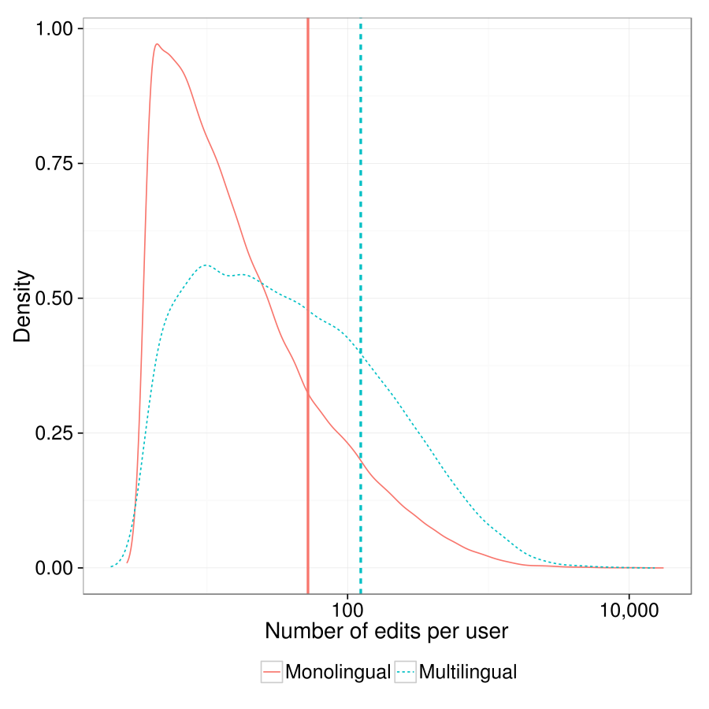
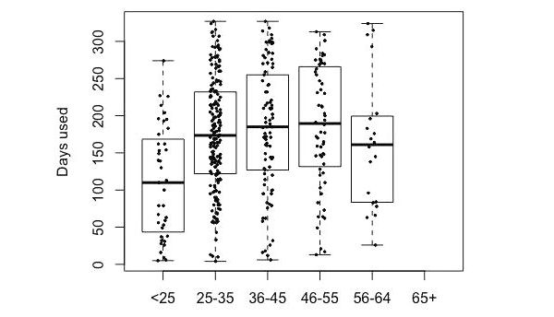
Distributional graphs
There is no example for this topic, but see this documentation for when you work on the weekly assignment
Multiple density plots and medians
(note the logarithmic scale!)
Boxplot (with actual data superimposed)

Slide 18
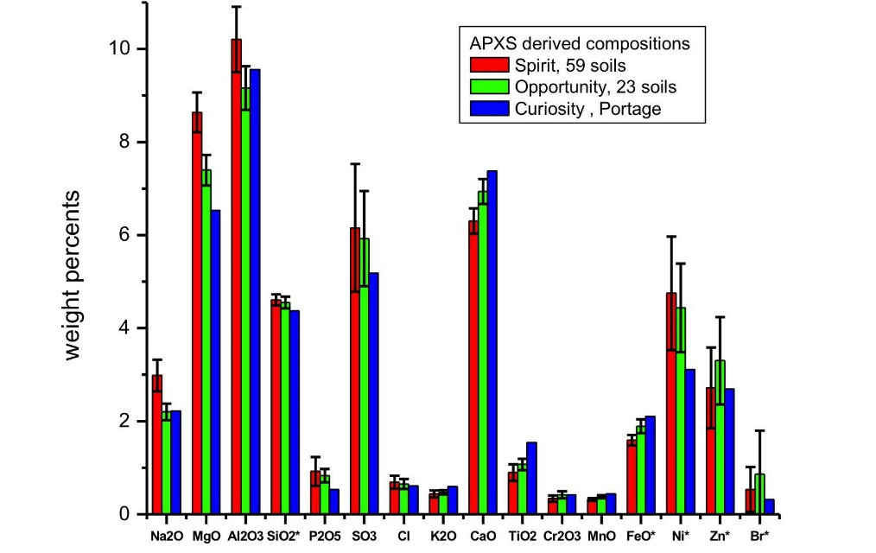
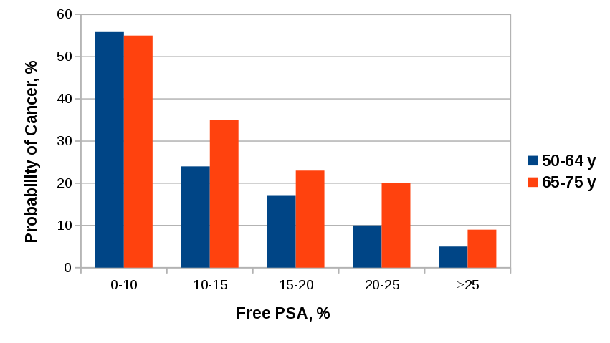
Bar graphs (summary data)
Without error bars (population data)
With error bars (sample data)

Slide 19
Bar graphs
Blog

Slide 20
Topics
Terminology
Exploring 1 or 2 categorical variables
Exploring 1 categorical & 1 numerical variable
Exploring 2 numerical variables

Slide 21
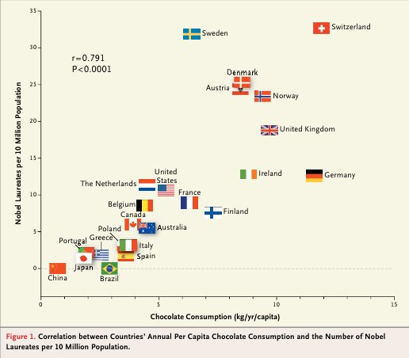
Relation between two numerical variables: scatterplot
Does chocolate consumption really boost Nobel Award chances?
Maurage, Heeren, & Pesenti (2013)

Slide 22
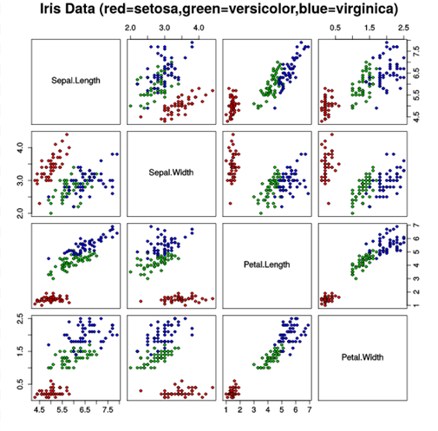
Scatterplot matrix

Slide 23
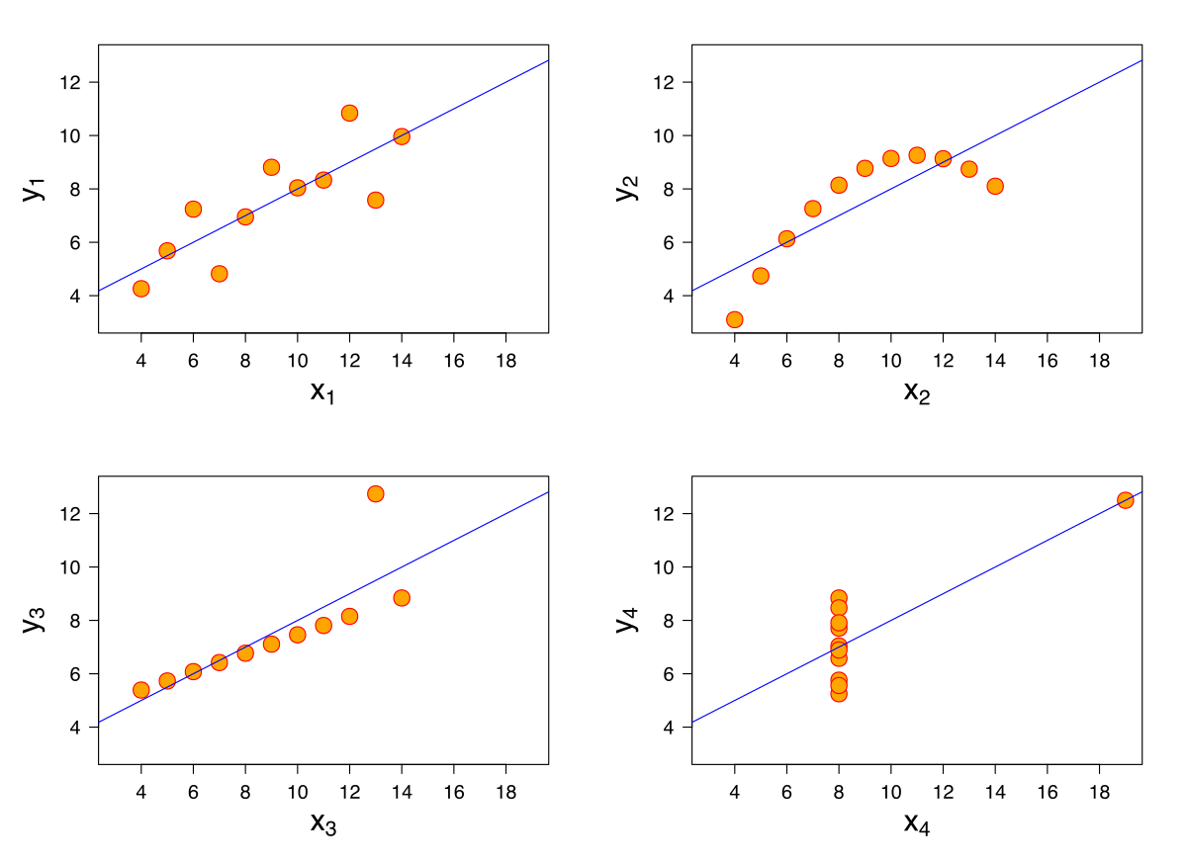
Anscombe’s quartet
All these data sets have the same mean, variance & correlation
Always visualize your data!

Slide 24
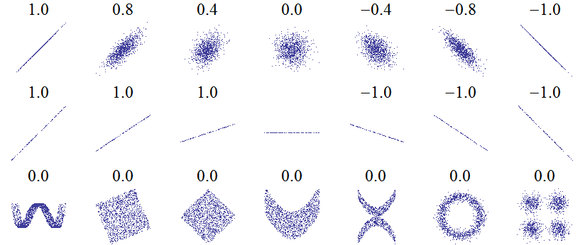
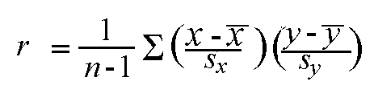
Correlation: Pearson’s r
Linear relations
Linear relations (perfect correlation)
Non-linear relations
r gives a measure of how much two quantitative variables ‘move together’
Correlation is normalized. The variation in the X and Y values is ‘cancelled out’, so that the result is always between -1 and 1

Slide 25
Strength and significance
Weak 0.1 < r < 0.3
Moderate 0.3 < r < 0.6
Strong > 0.6
Interpretation depends on context. Most correlations in social science are weak
Significance (p) indicates how likely the correlation found in the sample is, given no correlation in the population

Slide 26
Introducing the library and data set
sk-learn is the standard library for statistics and machine learning. We will be working with it a lot. Used in theird exercise
Scraped Funda data set: house listings in Amsterdam. Will be used these two weeks.

Slide 27
Exercise 2: correlations
See the correlation Notebook in Examples
Choose three numerical variables in the Funda data set (see exercise folder) that you expect are correlated. Include price.
Tips:
Remember that you can select columns in Pandas by using:
df_subset = df[[‘col_name1’, ‘col_name2’, ‘col_name3’]]
After you do this step, you will find that you need to some pre-processing (some values are implausible). Rather than replacing them with NaN (like in the Fitbit example), it seems better to remove these rows completely. Remember how to subset a dataframe?
Make: a scatterplot matrix and a correlation matrix. Visualize this matrix in a heat map.
Make: a scatterplot of one combination of two variables (think about which variable is most suited for x – the independent variable)
Comment on the linearity of the relationship.
Calculate Pearson’s r for this combination
What is your conclusion about the relation between the two variables?

Slide 28
Image credit
Bar bar plots by Page Piccinini (fair use)
Level of measurement by Johan van Berkel (HU)
Mars Curiosity by NASA (PD)
Free PSA bar graph by The RedBurn (CC-BY-SA)
Edit count by Computermacgyver (CC-BY-SA)
Nobel Prize and Chocolate by Maurage et al. (fair use)
Scatterplot matrix by Nicoguaro (CC-BY)
Anscombe’s quartet by Schutz (CC-BY-SA)

